Slide 2
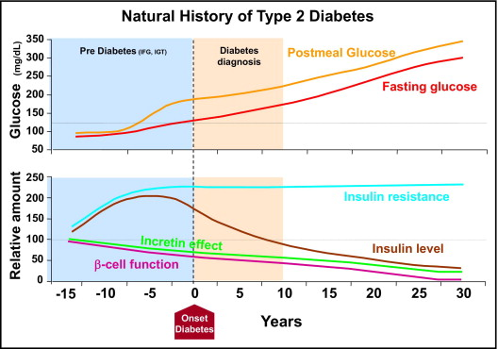
Figure 2
前糖尿病期
（境界型）
糖尿病と診断
食後血糖
血糖値
空腹時血糖
相対量
インスリン抵抗性
インスリンレベル
膵β細胞機能
糖尿病の発症
Kendall DM, et al.: Am J Med, 2009, 122(6 Suppl), S37
The American Journal of Medicine 2009 122S37-S50DOI: (10.1016/j.amjmed.2009.03.015)
Copyright © 2009 Terms and Conditions
Notes:
Representative depiction of the natural history of type 2 diabetes mellitus highlighting the role of insulin resistance, insulin deficiency, and impaired incretin effect. Both the time course and relative function are descriptive. These 3 core pathophysiologic defects likely combine to contribute to the progressive nature of the disease, and may account for much of the deterioration in glucose control observed clinical in patients with type 2 diabetes. IFG = impaired fasting glucose; IGT = impaired glucose tolerance. For glucose, 1 mg/dL = 0.5551 mmol/L. (Courtesy of the International Diabetes Center © 2008.)

